Slide 1
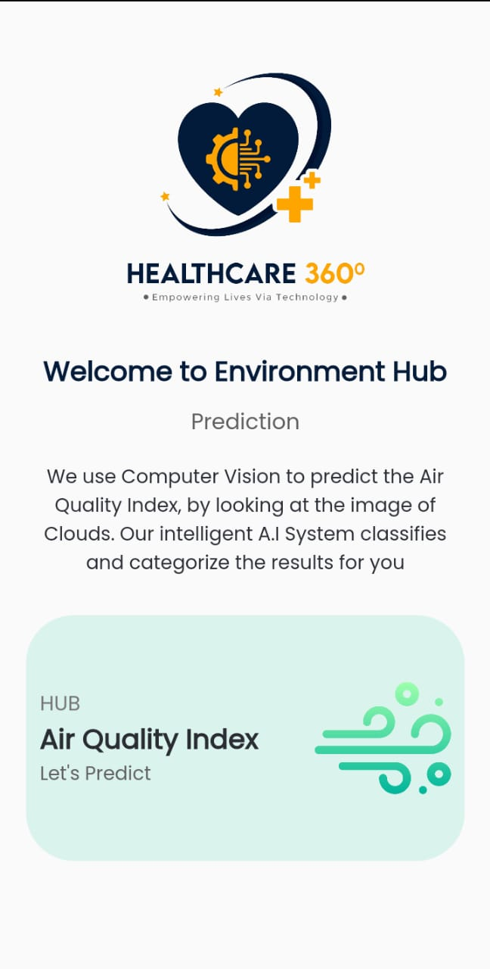
Air Cognizer Team Reliance – UET Peshawar
Notes:
Please keep the title brief and specific. You may place relevant graphics/images on the slide; a project picture would be preferred.

Slide 2
One Sentence Pitch
Air Cognizer is an Air Pollution Analytics Application.
Just take a picture from your smartphone of the sky nearby you and it will tell you the quality of air around you.
Get real time, location based Air Quality Index Analytics at your fingertips in a matter of seconds.
Notes:
My organization, (name of company)
is developing (a defined offering) [be specific, avoid buzzword e.g. “a website”, “a mobile application”, “hardware”]
to help (target audience) [identify demographics e.g. “women age between 25 to 35 years”, “system administrators at small technology businesses”]
(solve a problem) [specify your market e.g. “reduce the time collecting bill payments”]
(with secret sauce) [clarify the buyer e.g. "by sending automated email alerts based on analysis of highest response times"]
Ref: https://fi.co/madlibs

Slide 3
Introduction
Reliance
ORGANIZATION
Reliance Healthcare – UET Peshawar
MISSION
To eradicate the climate change & preserve our nature & air
PROJECT DIRECTOR
Department of Computer Systems Engineering, UET
BUDGET
PKR 10 USD
CORE TECHNOLOGY
Artificial Intelligence.
Cloud Computing
Clean Tech
Computer Vision
OBJECTIVES
•Inexpensive
•Portable
•Real-time
•Accurate
•Adaptive
•Reachable to masses
Notes:
Brief introduction of your company. Mission and objectives must be short and focused towards proposed project only.
CORE TECHNOLOGIES:
3D/4D Printing Augmented Reality / Virtual Reality Big Data Artificial Intelligence
Cloud Blockchain Robotics Neurotech
The Internet of Things Shared economy CleanTech Wearables, Implantables
Driverless Vehicles, Drones Programmable Hardware Synthetic Biology Quantum Computing/Supercomputers

Slide 4
The Problem
As the population of Pakistan touches the mark of 250 million people and is expected to be the world's 4th most populous country by 2024 , the requirement for generation of resources to meet the demands has increased rapidly. And to meet the demands of such a big population sustainable and sensible development approaches have been outlasted. The need of the hour is to create awareness among the people regarding the poisonous air they breathe in everyday. Air quality information can help people avoid hazardous environment and take respective measures. The government has taken steps and set up nodes at different places but air quality data is still not accessible by everyone and installing an air quality sensor at home is a costly affair.
Notes:
Problem(s) exists in current market. What is the problem you are trying to solve? Be Specific. Infographics may be added.
Support with numbers. Regulatory issues may be included.

Slide 5
The Solution to the Problem
To address this issue, we developed an Inexpensive, Portable and Realtime Air Quality Analytics Application: Air Cognizer.
Air Cognizer predicts the AQI from the images captured using a smartphone device.
Air Cognizer is an Air Pollution Analytics Application.
Notes:
What is your solution to the problem? Emphasize on the solution your startup will be providing to address the problem. A relevant image/graphic describing the product would be preferred.

Slide 6
Comparison Matrix
We are the first movers in this market, right now we don’t have any competitors in this category and domain.
We are good to disrupt the market with our innovative approach
Notes:
Please provide a comparison matrix (including cost) of key available products and proposed solution.

Slide 7
Market / Opportunity
THE TARGET MARKET
Healthcare (Clean & Green Energies Tech)
TOTAL TARGET MARKET SIZE
Global & National Horizons
MARKET SHARE THAT THE COMPANY WILL TARGET
95%
Notes:
Please describe the target market, explain possibilities of the total market size, and volume of market share. Infographics may be added.
TARGET MARKETS:
Automotive, Aviation, Marine Business, Marketing, Finance Defence, Security, Safety
Education & Training Environment, Water Management Entertainment, Tourism, Sport/Recreation
Food, Livestock, Agribusiness Healthcare Infrastructure, Housing & Transport
Mining Equipment Technology & Services Oil, Gas, Energy Textiles, Clothing, Footwear

Slide 8
Go to Market Strategy
Launch a beta version to make people familiarize
Target Lahore & Karachi as the AQI conditions are worst.
Within 6 months of feedback, launch a complete scaled product.
Within 1-year the application user base to be targeted as 70 Million
After 18 months, will have a very cheap monthly or yearly subscription for revenue generation.
No ads policy will be implemented by our company.
Notes:
What is your advantage over the competition? Proprietary technology? Key partners/customers? Better distribution channel? Did you identify the customers? Did you contact customers and how many would be interested to get the product? Do you have partners to go in international market?

Slide 9
Why Us? Why Now?
We are the first movers in this market
We are unique and innovative
We have our laboratory tests & trials undergoing
We are the market disrupters in this domain
AQI of Pakistani cities are deteriorating badly.
Notes:
Explore the competition/trends in the market. How is your company different? What is your passion? Why are you doing this and others cannot? Highlight achievements.

Slide 10
Product Cost Matrix
description | AMOUNT
R&D Cost | 1000USD
Raw Material / Components | 50 USD
Assembly | NA
Manufacturing Overheads | NA
Distribution Overheads | NA
Quality Assurance and Certification | 1000USD
Sales Overheads | NA
General, Marketing and Admin | NA
Support and Maintenance | 500USD
Profit Margin | 10 USD Subscription
Others | NA
Total (Retail Cost): | 10 USD Per unit (Subscription Model)
Notes:
Calculate the product retail cost using above breakup. Product retail/selling price may include R&D cost, raw material, assembly, manufacturing overheads, distribution overheads, sales overheads, marketing, general admin expenses, quality assurance, certifications, support and maintenance, profit margins etc.
You may change the cost heads as deemed necessary.

Slide 11
Financial Strategy
REVENUE MODEL
Monthly – Yearly Subscription Model
CASH FLOW PROJECTIONS
10 USD per unit
Notes:
Explain how the business will make money i.e., market share, pricing, revenue model. Infographics may be added.
2 years’ projections to be shown here.
Must show acquisition of next round of funding.

Slide 12
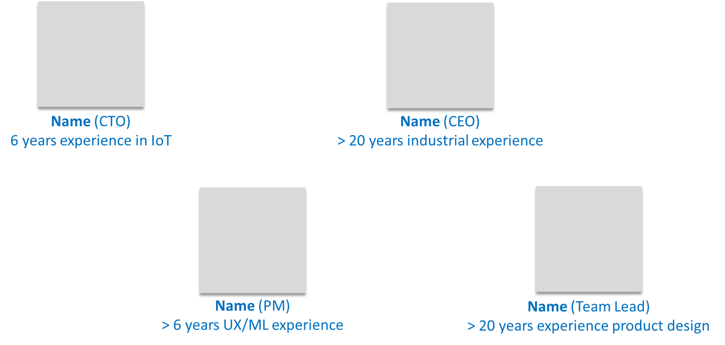
Project Team
Raja Ahmed Sajjad (Chief Executive Officer)
Ashley Alex Jacob (Chief Technology Officer)
Syeda Fatima Ashoor (Chief Financial Officer)
Affifa Zainab Ahmad (Chief Information Officer)
SPECIMEN
Notes:
Detail of the Management Team. An organogram may be preferred.

Slide 13
Thank You!

